Slide 1
Matrix

Slide 2
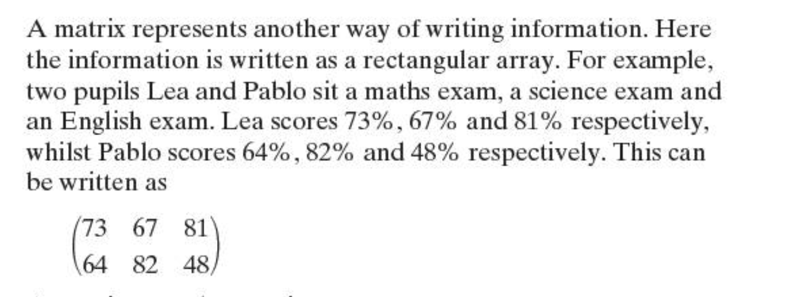

Slide 3
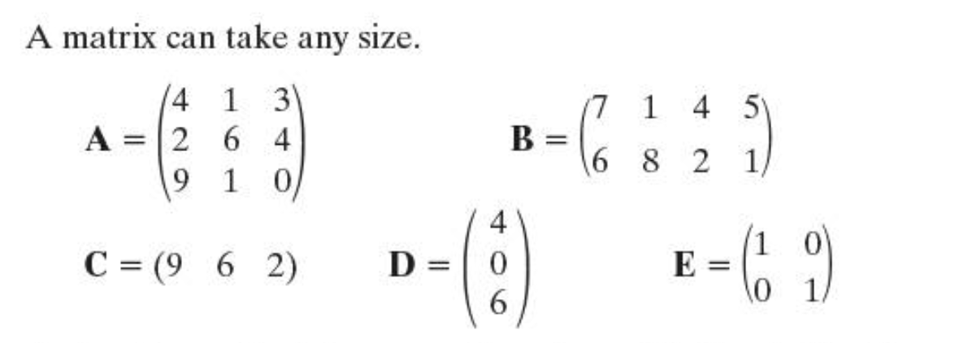
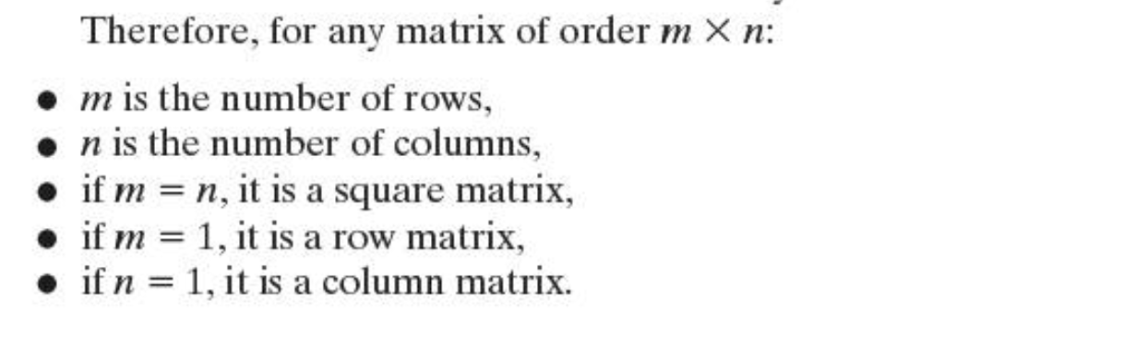
Order & Elements
Squre Matrices, Row Matrices & Colomn Matrices

Slide 4
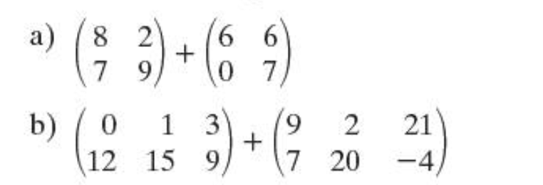
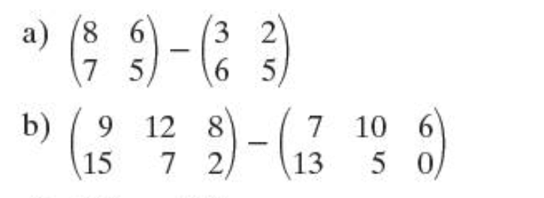
Addition and Subtraction of matrices

Slide 5
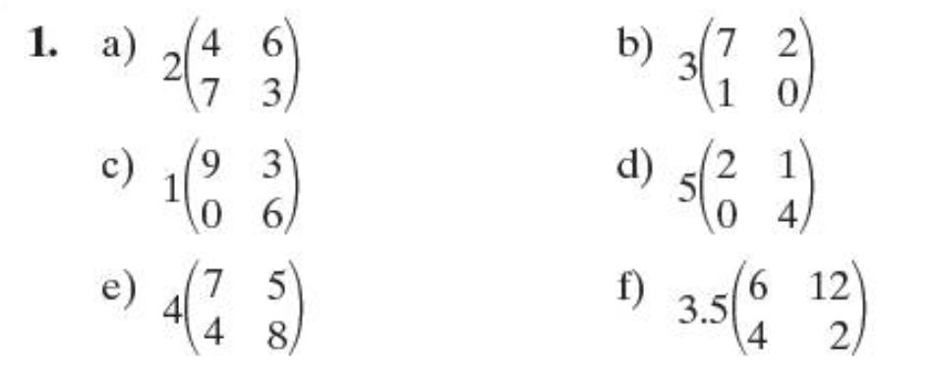
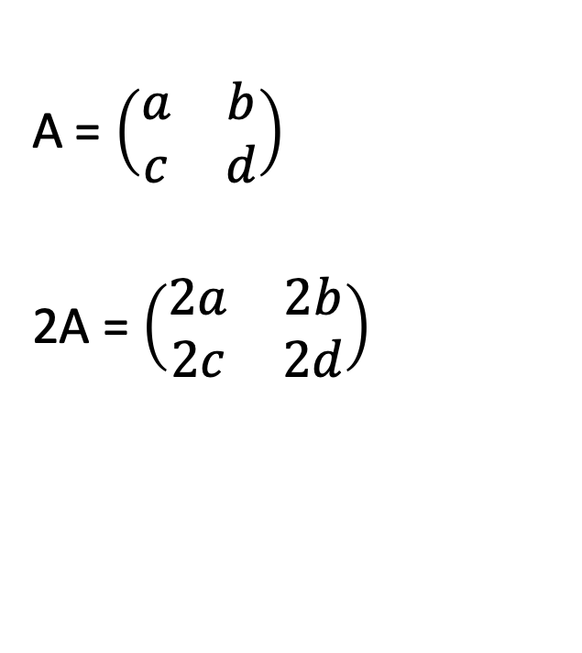
Multiplying matrices by a scalar quantity
A = $\left(\begin{matrix}a & b \\ c & d\end{matrix}\right)$
2A = $\left(\begin{matrix}2a & 2b \\ 2c & 2d\end{matrix}\right)$

Slide 10
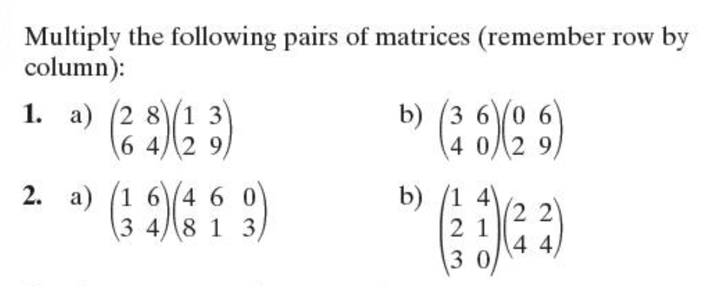
Let’s Practise!

Slide 11
The identity matrix
https://www.youtube.com/watch?v=iks8wCfPerU
The zero matrix
https://www.youtube.com/watch?v=LOf8bfjiLow

Slide 17
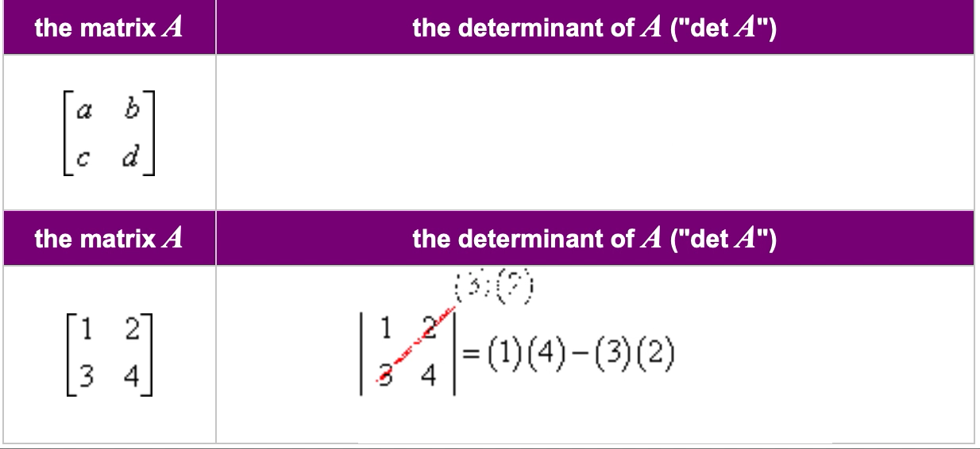
The Determinants of 2x2 matrix

Slide 18
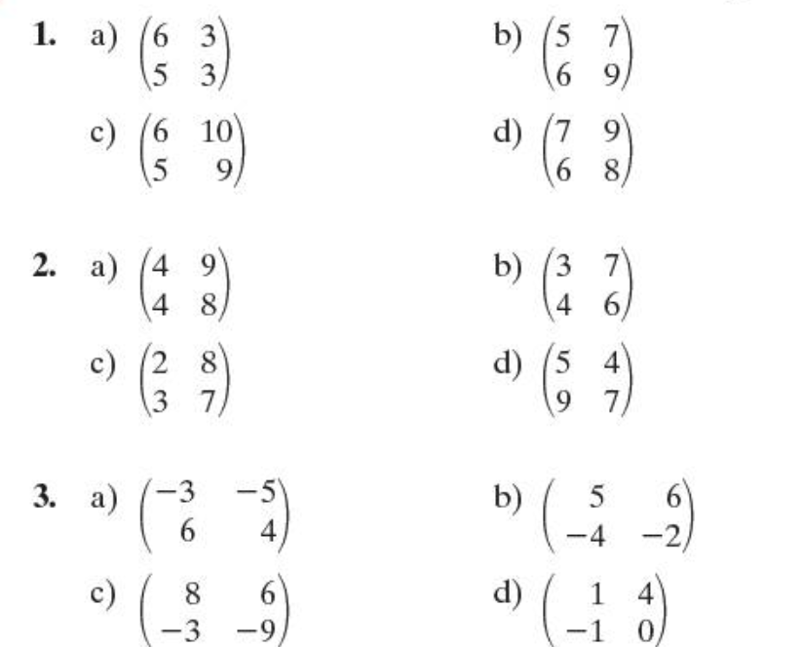
Determinant practice

Slide 19
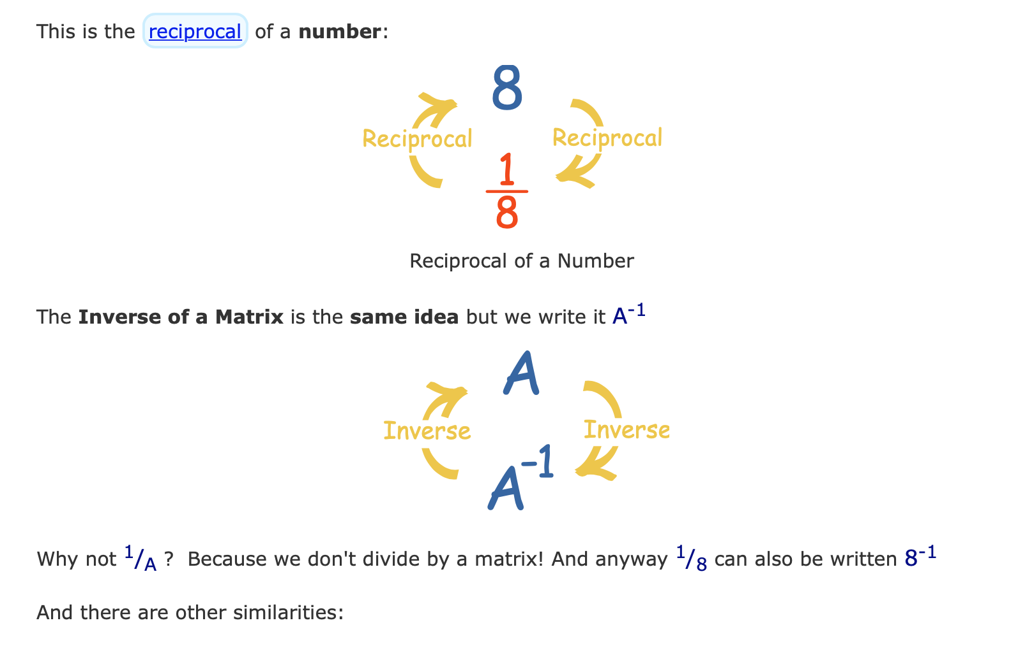
The inverse of a matrix

Slide 20
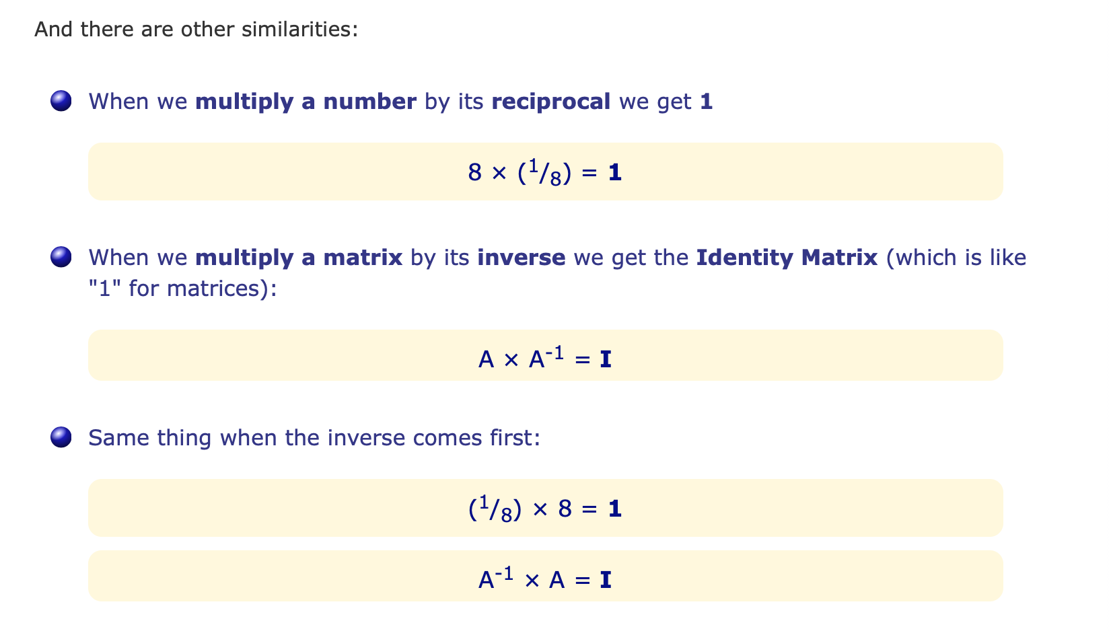

Slide 21
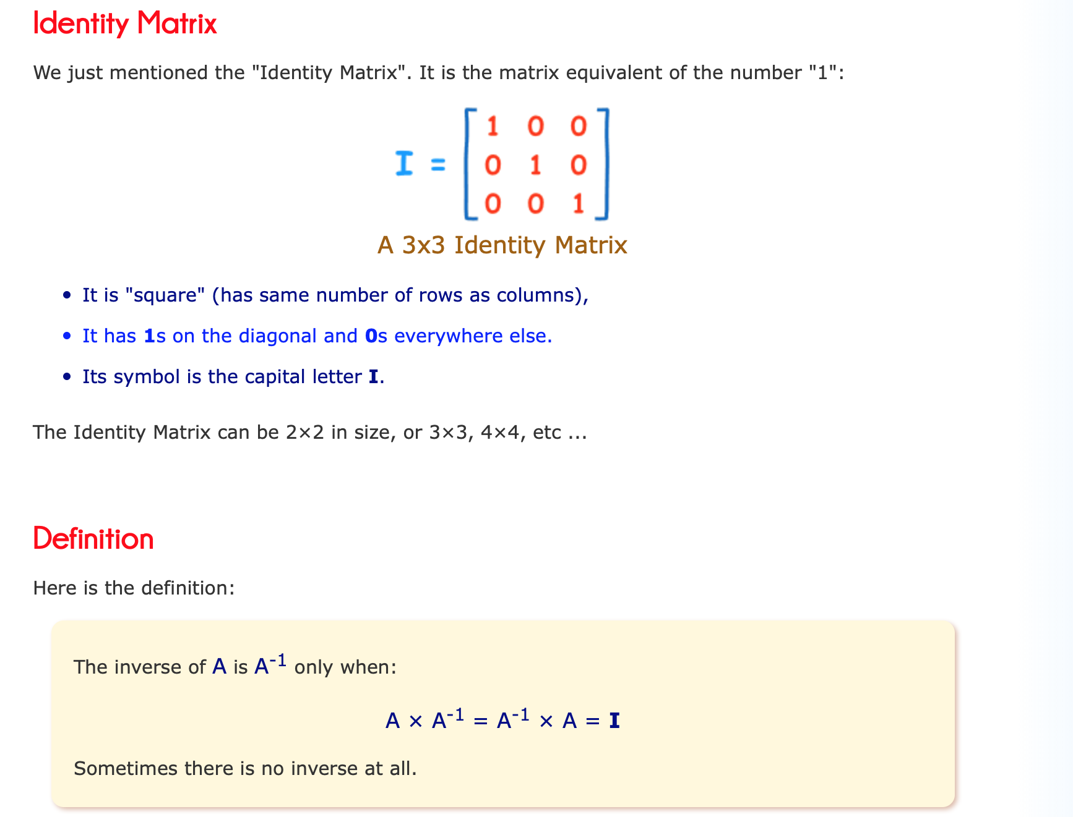

Slide 22
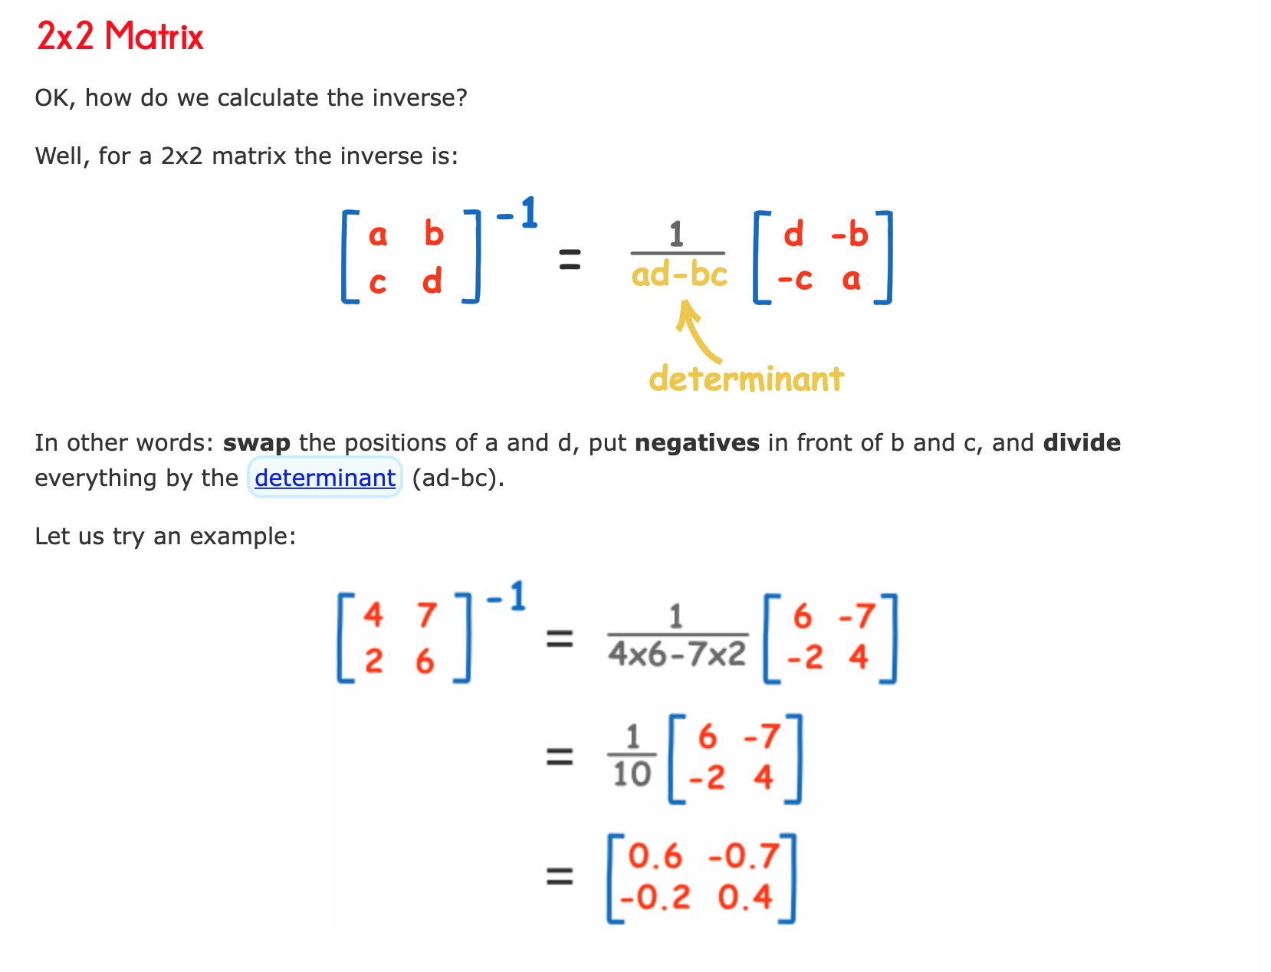

Slide 23
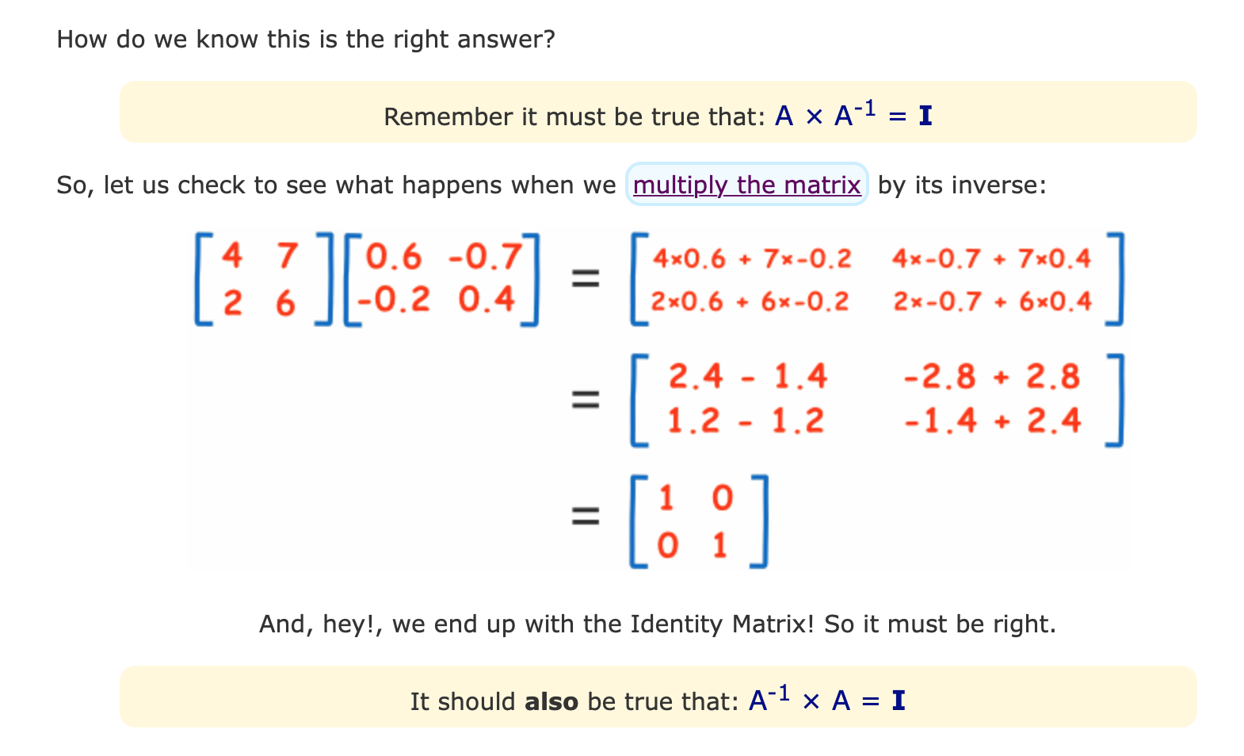

Slide 24
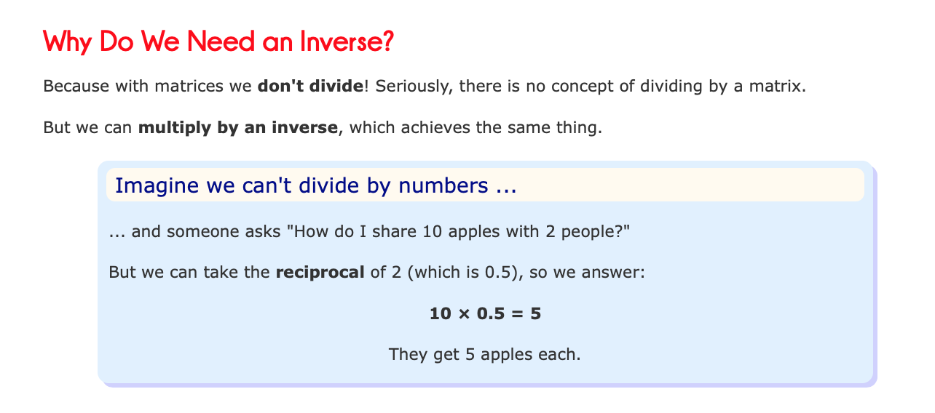

Slide 25
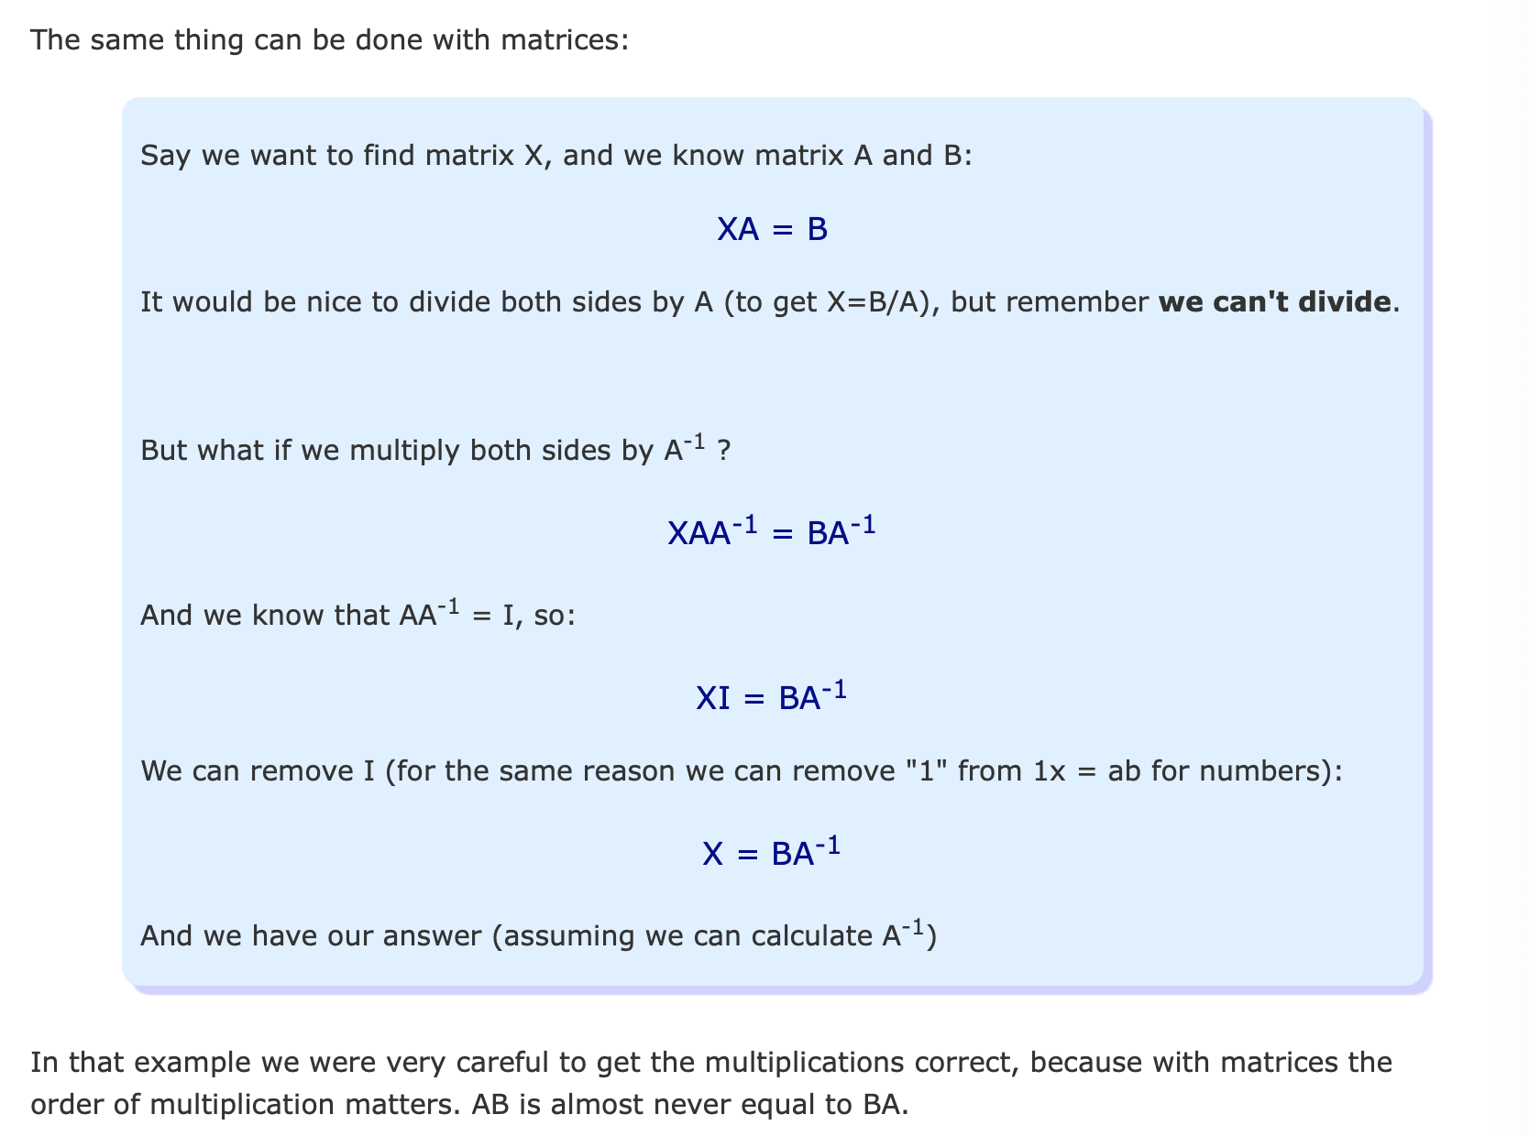

Slide 26
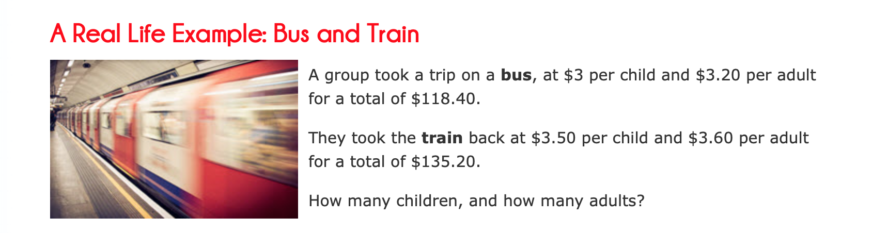

Slide 27
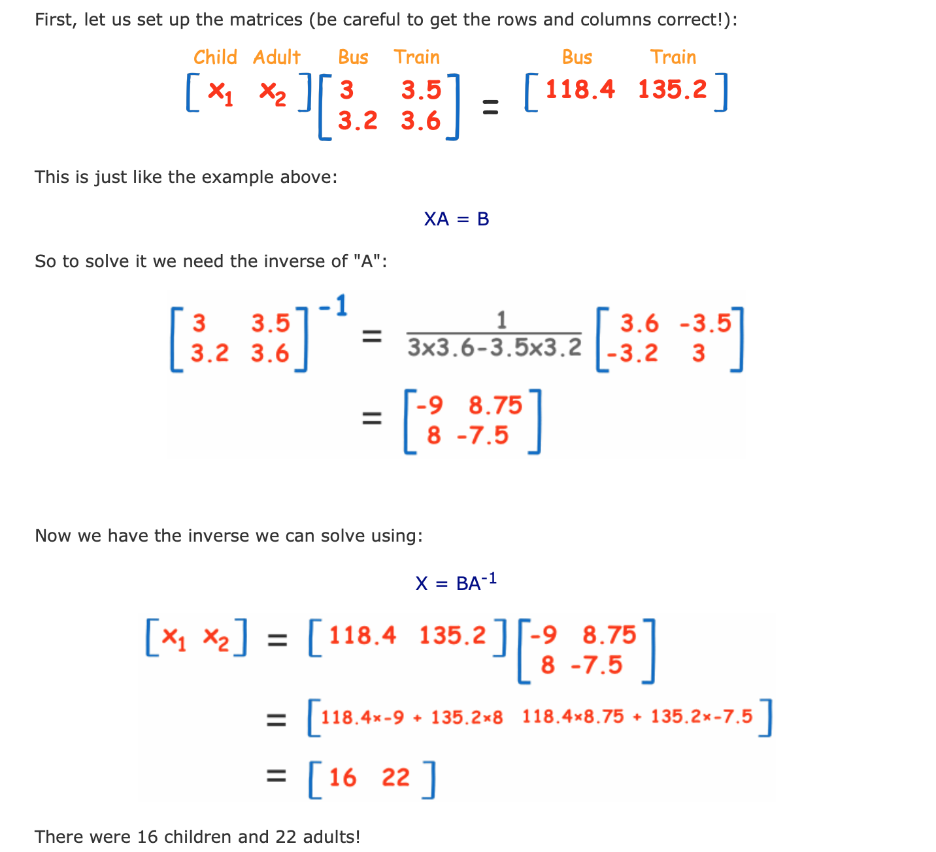

Slide 28
